Slide 1
Rivalry on the Rhine
The Battle of the Neighborhoods
Y. K.

Slide 2
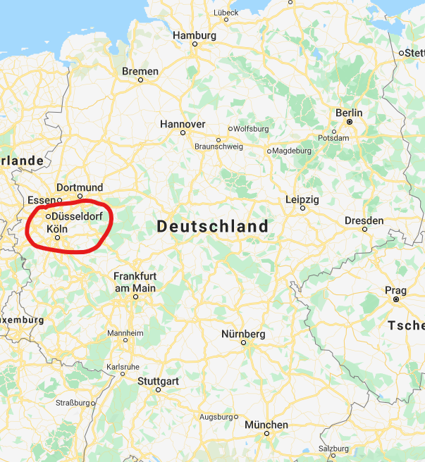
Background and Motivation
Cologne vs. Düsseldorf
two major cities in western Germany
only about 40 km apart on the Rhine.
similarities in many aspects but competitive relationship
Data-driven analysis
to investigate how similar/dissimilar both cities are
to help tourists or people/groups who want to develop business make their first decision on place selection

Slide 3
Data and Methodology
Data exploration
Boroughs/neighborhoods containing names and geospatial coordinates by scraping wiki and related webpages
Common venue categories in each neighborhood by the Foursquare explore function
Methodology
The Folium library – Visualization of neighborhoods and their distributions on interactive map
k-means clustering algorithm – Grouping city neighborhoods into clusters
Word clouds of venue categories in city neighborhoods – Identification & Intuitive comparison of really stand-out categories in the city

Slide 4

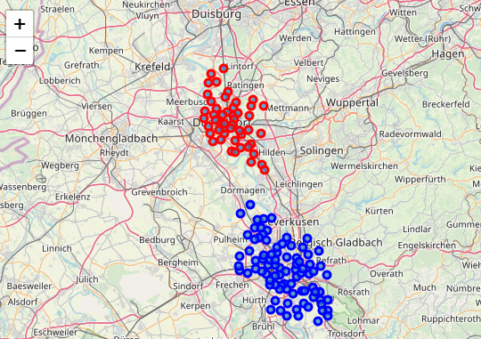
Cologne vs. Düsseldorf
Basics of Cologne and Düsseldorf
Map with Cologne and Düsseldorf neighborhoods

Slide 5
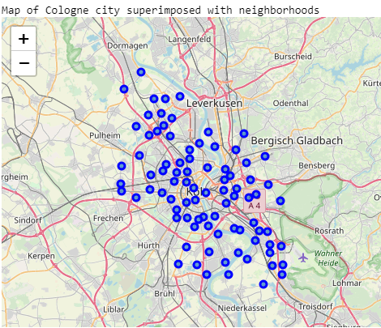
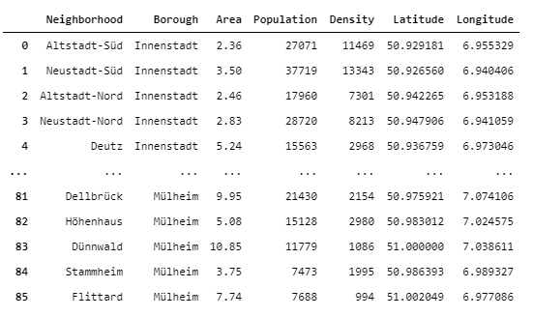
9 boroughs and 86 neighborhoods
Neighborhoods in Cologne

Slide 6
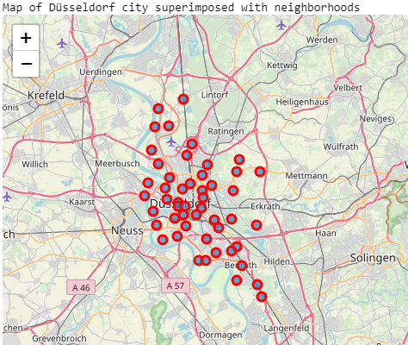
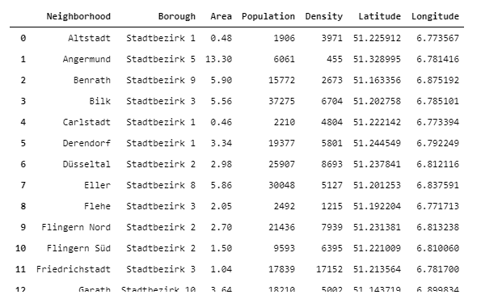
10 boroughs and 50 neighborhoods
Neighborhoods in Düsseldorf

Slide 7
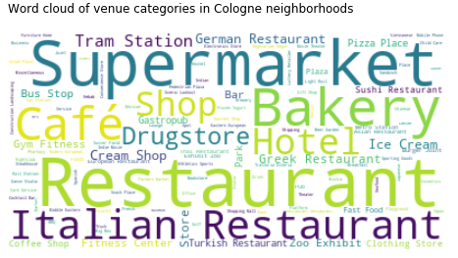
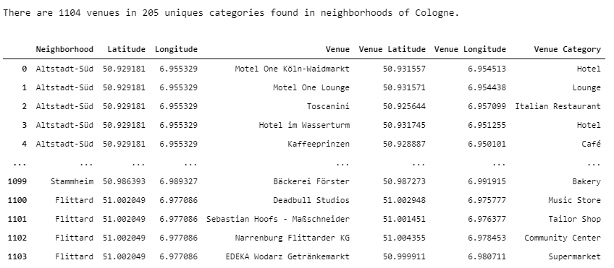
Most common venue categories
Neighborhoods in Cologne

Slide 8
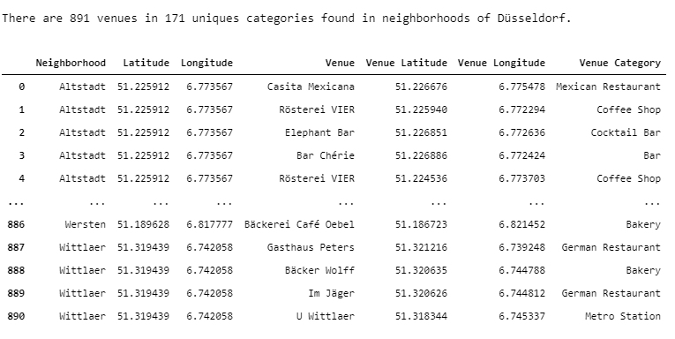
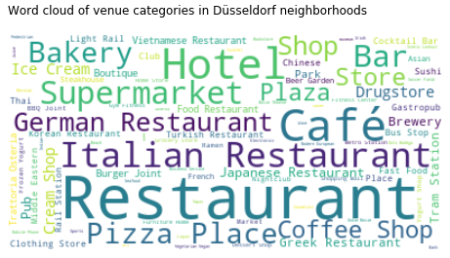
Most common venue categories
Neighborhoods in Düsseldorf

Slide 9
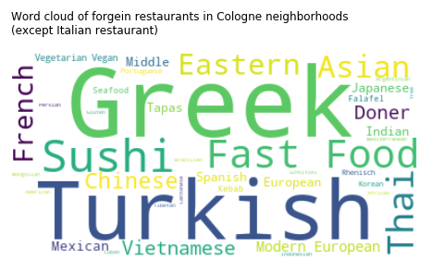
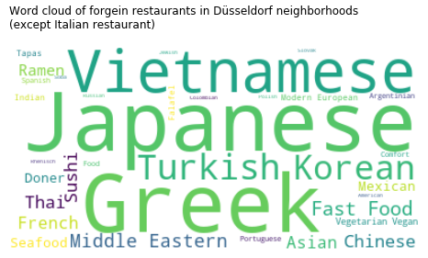
Most common foreign restaurants
Cologne vs. Düsseldorf

Slide 10
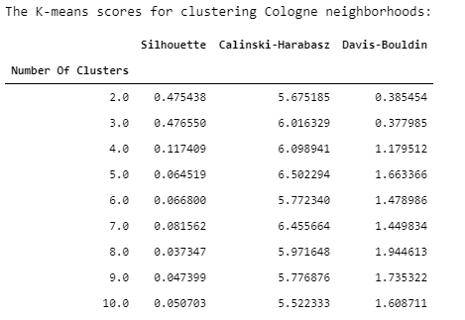
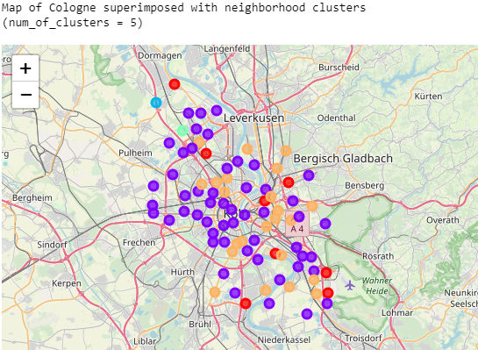
Neighborhood segmentation/clustering
The city of Cologne

Slide 11
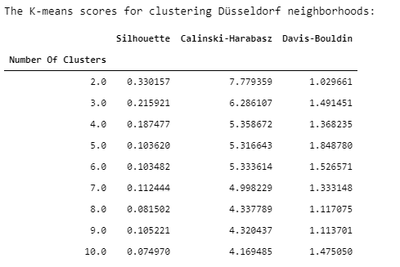
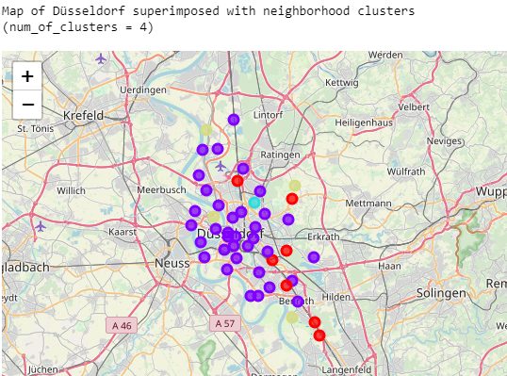
Neighborhood segmentation/clustering
The city of Düsseldorf

Slide 12
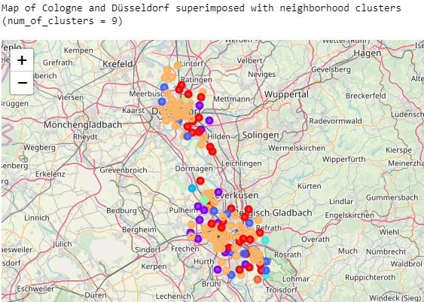
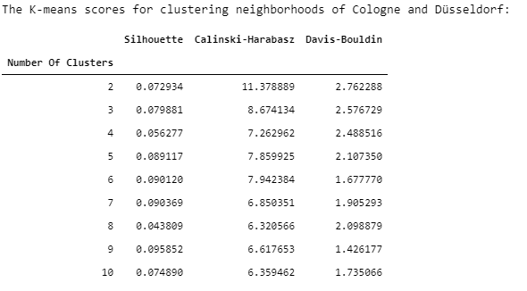
Neighborhood segmentation/clustering
Cologne + Düsseldorf

Slide 13

Summary & Conclusion
Based on the venue category data obtained by the Foursquare explore function, the neighborhoods in the cities of Cologne and Düsseldorf have been analyzed.
The results of neighborhood segmentation indicated that the neighborhoods in Cologne and Düsseldorf are not well distinguished by their venue data.
In Summary,
Cologne and Düsseldorf are very similar, and there is no real rivalry in everyday life.

